Slide 1

INSTITUTE :UIE
DEPARTMENT: ALL ACADEMIC UNITS
Bachelor of Engineering (All Sections)
Subject Name and Code:
Engineering Physics 23SPH-141
Prepared by: Deepak Kumar, Asso. Prof. Physics
FIBRE OPTICS
DISCOVER . LEARN . EMPOWER

Slide 2
Course Objectives
The course is designed to make the students industry ready to contribute in the growing demand of the industry at local, national and international level.
It will make the students competent to understand basic concepts and applications of advanced engineering physics and apply its principles in their respective fields at global platform.
It will enhance the skill level of the students and shall make them preferred choice for getting employment in industry and research labs.
It will give thorough knowledge of the discipline to enable students to disseminate knowledge in pursuing excellence in academic areas.

Slide 3
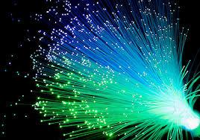
Course Outcomes
CO Number | Title On completion of this course, the students are expected to learn | Level
CO1 | Quote the basic fundamental concepts of lasers, optical fibres, crystallography, ultrasonic oscillations, semiconductor physics, quantum mechanics and nanotechnology. | Remember, Understand
CO2 | Demonstrate the working of various lasers, fibre components, semiconductor devices; explain the behaviour of crystalline solids, quantum and nano-scale systems. | Understand
CO3 | Solve problems by applying principles related to lasers, fibres, semiconductors, oscillations, quantum and nanoscience. | Applying
CO4 | Compare various lasers and fibres, semiconducting devices, crystalline materials, structures at quantum and nanoscale on the basis of their properties for industrial applications. | Analyze
CO5 | Develop various systems using lasers, fibres, semiconductors and nanomaterials for futuristic applications. | Design
Figure 2.1 Optical fibres [1]

Slide 4
Brief Flow of Presentation
Brief Introduction
Optical fiber construction
Critical angle & Total Internal Reflection
Acceptance angle & acceptance cone
Numerical Aperture
V-Number
Types of fibers
Dispersion & its types
Attenuation and Losses in Fiber
Advantages
Disadvantages
Applications
Figure 2.2 Basic structure and parts of optical fibre [2]

Slide 5
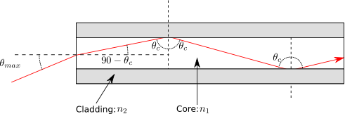
Acceptance angle and acceptance cone
Acceptance angle
It is the maximum angle of a ray (against the fiber axis) hitting the fiber core which allows the incident light to be guided by the core.
Acceptance angle
Figure 2.3 Acceptance angle of a typical step index fiber with a fiber core of refractive index n₁ [6]

Slide 6
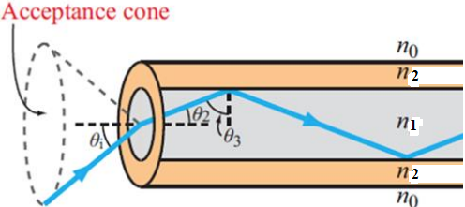
Acceptance cone
In fiber optics, the cone within which optical power may be coupled into the bound modes of an optical fiber. Here, the acceptance cone is derived by rotating the acceptance angle about the fiber axis.
Figure 2.4 Acceptance cone of an optical fiber [7]

Slide 7
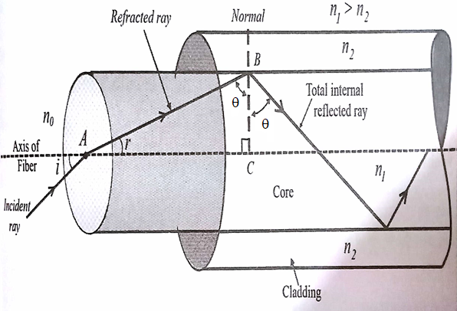
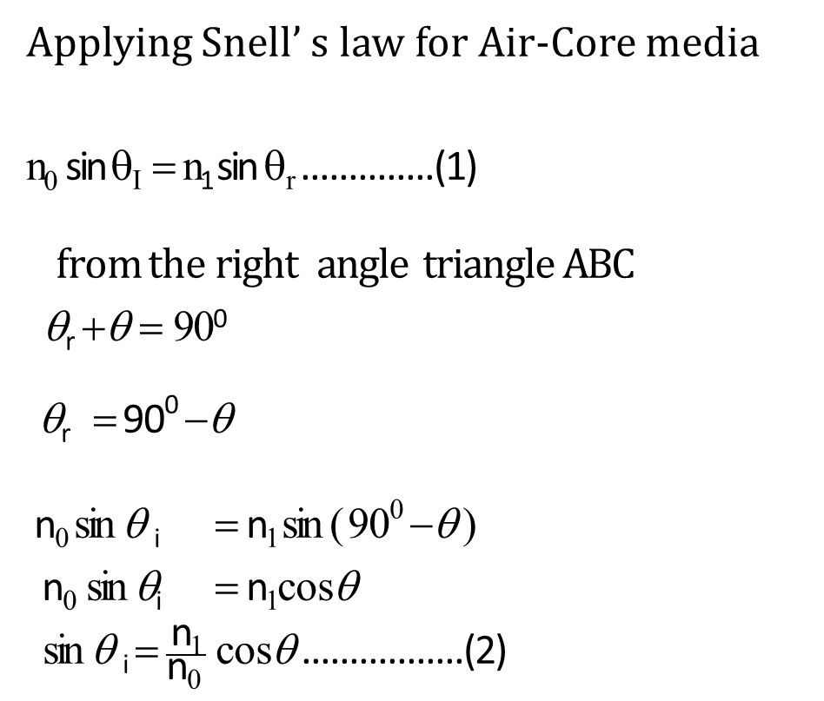
Expression of Acceptance angle
Applying Snell’ s law for Air-Core media
n₀ sin θ_{I} = n₁ sin θ_{r} ..............(1)
from the right angle triangle ABC
θ_{r} +θ = 90⁰
θ_{r} = 90⁰ −θ
n₀ sin θ _{i} = n₁ sin ( 90⁰ −θ )
n₀ sin θ_{i} = n₁cosθ
sin θ _{i} = $\frac{\text{n}\text{1}}{\text{n}\text{0} }$ cosθ .................(2)
Figure 2.5 Diagram of Acceptance angle [8]

Slide 8

when θ = critical angle (θ_{c} ) → θ_{i} = θ_{m}
sin θ_{m}= $\frac{\text{n}\text{1}}{\text{n}\text{0 }}$ cosθ _{c} …………………. (3)
according to law of refraction
n₁ sin i = n₂ sin r
here i = θ_{c} → r = 90
sinθ _{c} =$\frac{\text{n}\text{2}}{ \text{n}\text{1} }$ sin 90 =$\frac{\text{n}\text{2}}{\text{n}\text{1} }$
cos θ _{c} = $\sqrt{1−\sin^{2}}$θ = $\sqrt{1−\left(\frac{n_{2}}{n_{1}}\right)}$²

Slide 9

Cos θ _{c} =$\frac{\sqrt{n_{1}^{2} − n_{2}^{2}}}{n_{1}^{2}}$ ……………........... (4)
substitute equation (4) in (3)
sin θ_{m}= $\frac{\text{n}\text{1}}{\text{n}\text{0 }}$ $\frac{\sqrt{n_{1}^{2} − n_{2}^{2}}}{n_{1}^{2}}$
if the medium surrounding the fiber is air, then n₀ = 1
sin θ_{m}= $\sqrt{n_{1}^{2} −n_{2}^{2}}$
θ_{max} = sin$−1 \sqrt{n_{1}^{2} −n_{2}^{2}}$
Which is the required expression for maximum Acceptance Angle in optical fibers.

Slide 10
Summary
Brief Introduction
Optical fiber construction
Critical angle & Total Internal Reflection
Acceptance angle & acceptance cone

Slide 11
Assessment Test
Quiz link for Assessment Test:-
https://docs.google.com/forms/d/e/1FAIpQLSdoaR30UPyyOY0IRVyChKPoZVB99BOTYyw61SPEVbYoxNepFQ/viewform?usp=pp_url
Home Assignment :-
Q.1 Determine the expression for critical angle?
Q.2 Is acceptance angle depend on size of cable?

Slide 12
References
[1] https://www.ispreview.co.uk/index.php/2013/07/alcatel-lucent-breaks-record-with-31tbps-over-a-single-fibre-optic-cable.html
[2] http://constructionmanuals.tpub.com/14026/css/Fiber-Buffers-193.htm
[3] https://www.slideshare.net/ankushsaini123/6796optical-fibres
[4] https://www.slideshare.net/MadhumitaTamhane/optical-fiber-communication-part-1- optical-fiber-fundamentals
[5] (a) http://constructionmanuals.tpub.com/14026/css/Fiber-Buffers-193.htm
(b) https://computer.howstuffworks.com/fiber-optic2.htm
[6] https://www.slideshare.net/PratyushSrivastava8/optical-fiber-cable- v2?from_action=save
[7] https://www.ques10.com/p/21598/derive-the-expression-of-numerical-aperture- for-a-/
[8] https://www.explainthatstuff.com/fiberoptics.html
[9] http://fiberonda.com/single-mode-vs-multi-mode-fiber-optic-cable/
[10] https://images.app.goo.gl/LLWfgV3PjgLc9RbDA

Slide 13
Text book
Beiser A., Ghatak A, Garg S.C., Applied Physics, Edition 1st, (2013), Tata McGraw-Hill, Noida.
Laud B.B., Laser and Non -Linear Optics, Edition 1st, (1991), Wiley Eastern Ltd.
E- content
http://www.fiberopticshare.com/what-are-the-components-of-optical-fiber.html

Slide 14
THANK YOU
For Queries:-
deepak.e1972@cumail.in

